Slide 1
CSY2082 Introduction to Artificial Intelligence
Support Vector Machines

Slide 2
Support Vector Machine
A Support Vector Machine (SVM) is a very powerful and versatile Machine Learning model, capable of performing linear or nonlinear classification, regression, and even outlier detection.
SVMs are particularly well suited for classification of complex but small- or medium-sized datasets.

Slide 3
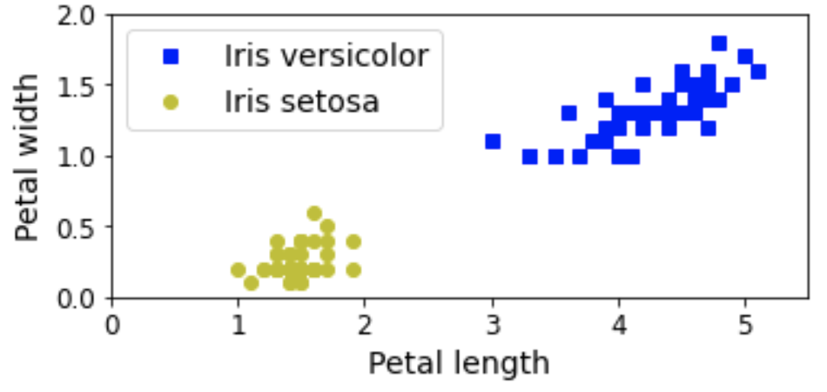
Support Vector Machine

Slide 4
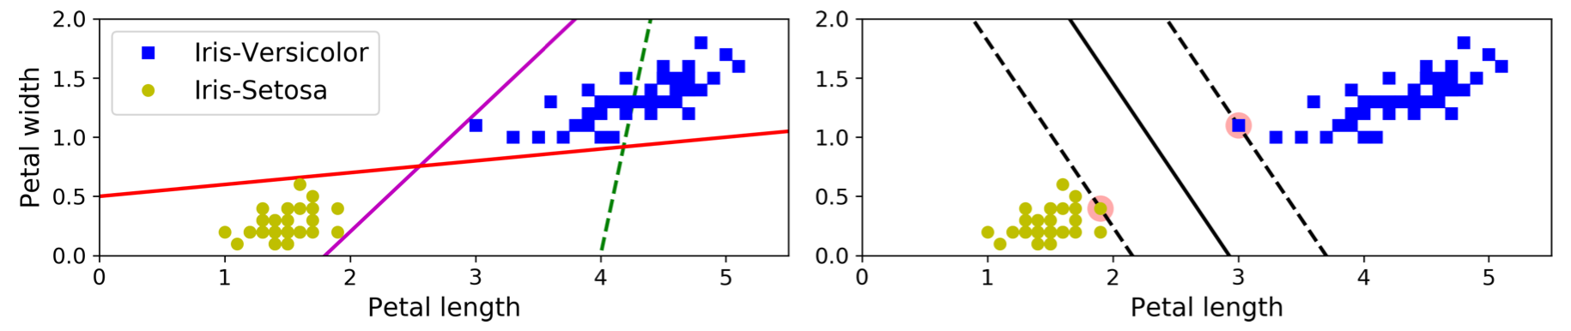
Linear SVM Classification
Solid lines OK but decision boundaries very close to instances that these models will probably not perform as well on new instances.
SVM classifier fitting the widest possible street (represented by the parallel dashed lines) between the classes. This is called large margin classification.
Decision boundary is fully determined (or “supported”) by the instances located on the edge of the street. These instances are called the support vectors (circled)

Slide 5
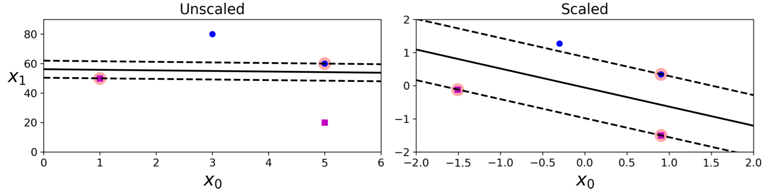
Linear SVM Classification
SVMs are sensitive to the feature scales
on the left plot, the vertical scale is much larger than the horizontal scale, so the widest possible street is close to horizontal.
After feature scaling (e.g., using Scikit-Learn’s StandardScaler), the decision boundary looks much better (on the right plot).

Slide 6
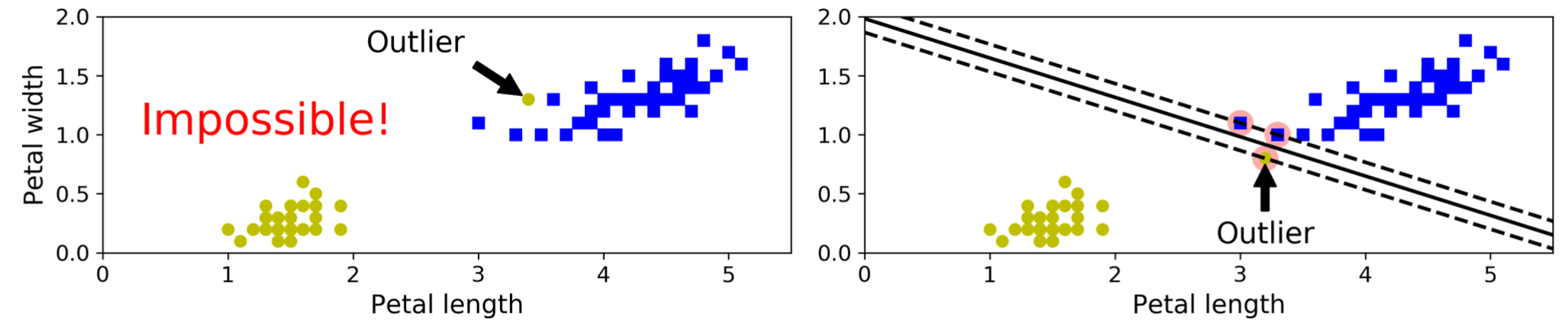
Hard Margin Classification
If we strictly impose that all instances be off the street and on the right side, this is called hard margin classification.
Two main issues :
it only works if the data is linearly separable
it is quite sensitive to outliers.

Slide 7
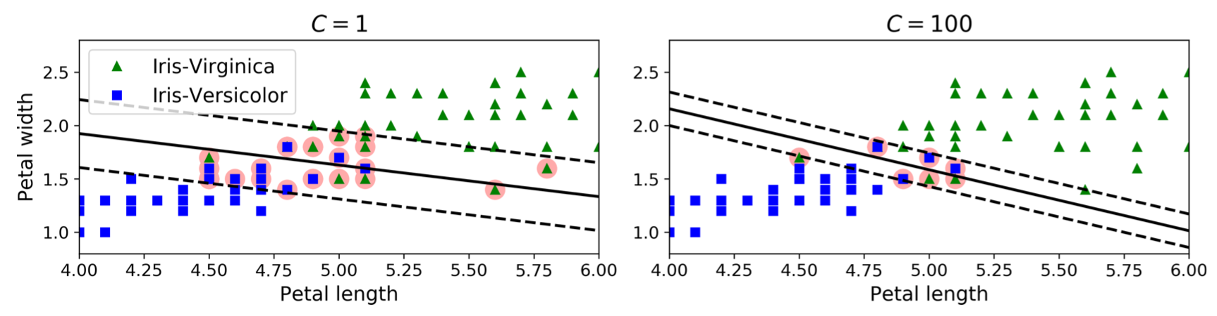
Soft Margin Classification
To avoid these issues it is preferable to use a more flexible model.
The objective is to find a good balance between keeping the street as large as possible and limiting the margin violations. This is called soft margin classification.
In Scikit-Learn’s SVM classes, you can control this balance using the C hyperparameter: a smaller C value leads to a wider street but more margin violations.

Slide 8
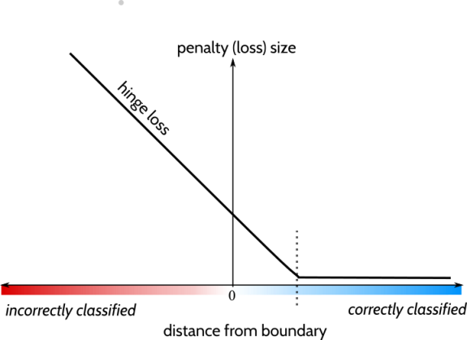
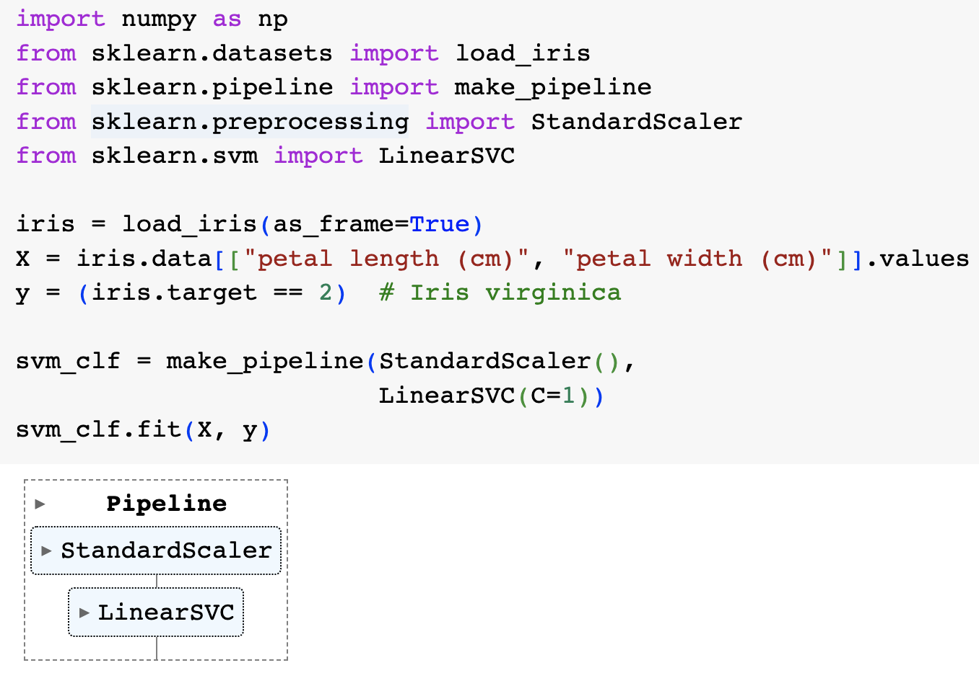
LinearSVC

Slide 9
Hinge loss
“Find me a line that produces the widest street between the 2 classes”.

Slide 10
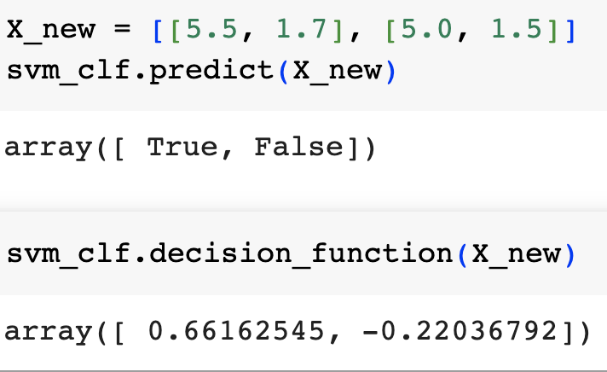
LinearSVC

Slide 11
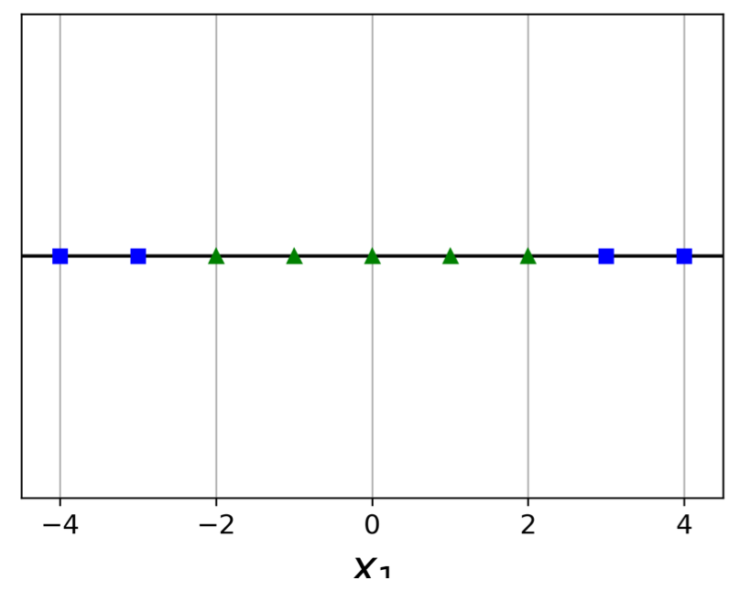
Nonlinear SVM Classification

Slide 12
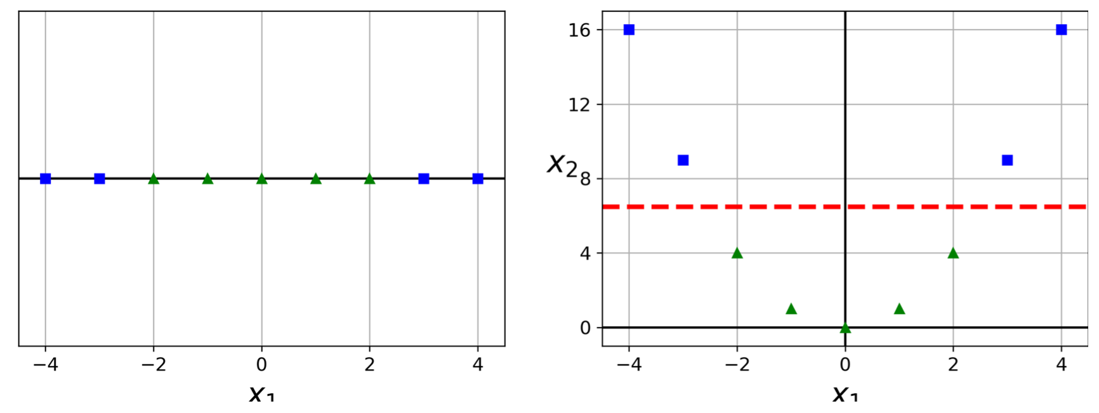
Nonlinear SVM Classification
One approach to handling nonlinear datasets is to add more features, such as polynomial features; in some cases this can result in a linearly separable dataset.

Slide 13
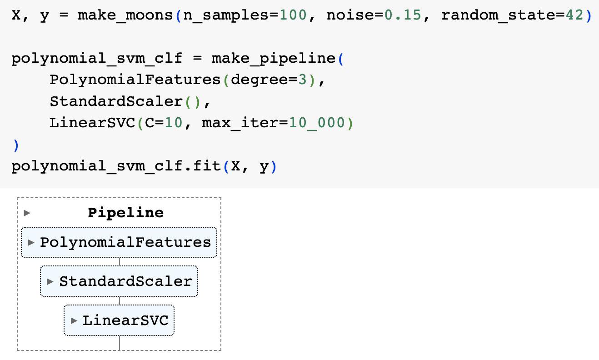
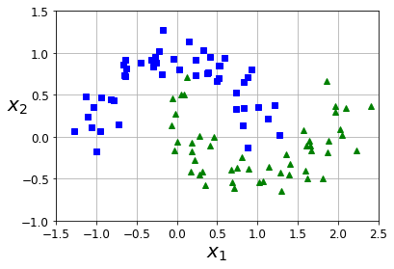
Nonlinear SVM Classification
sklearn.datasets.make_moons. Make two interleaving half circles. A simple toy dataset to visualize clustering and classification algorithms.

Slide 14
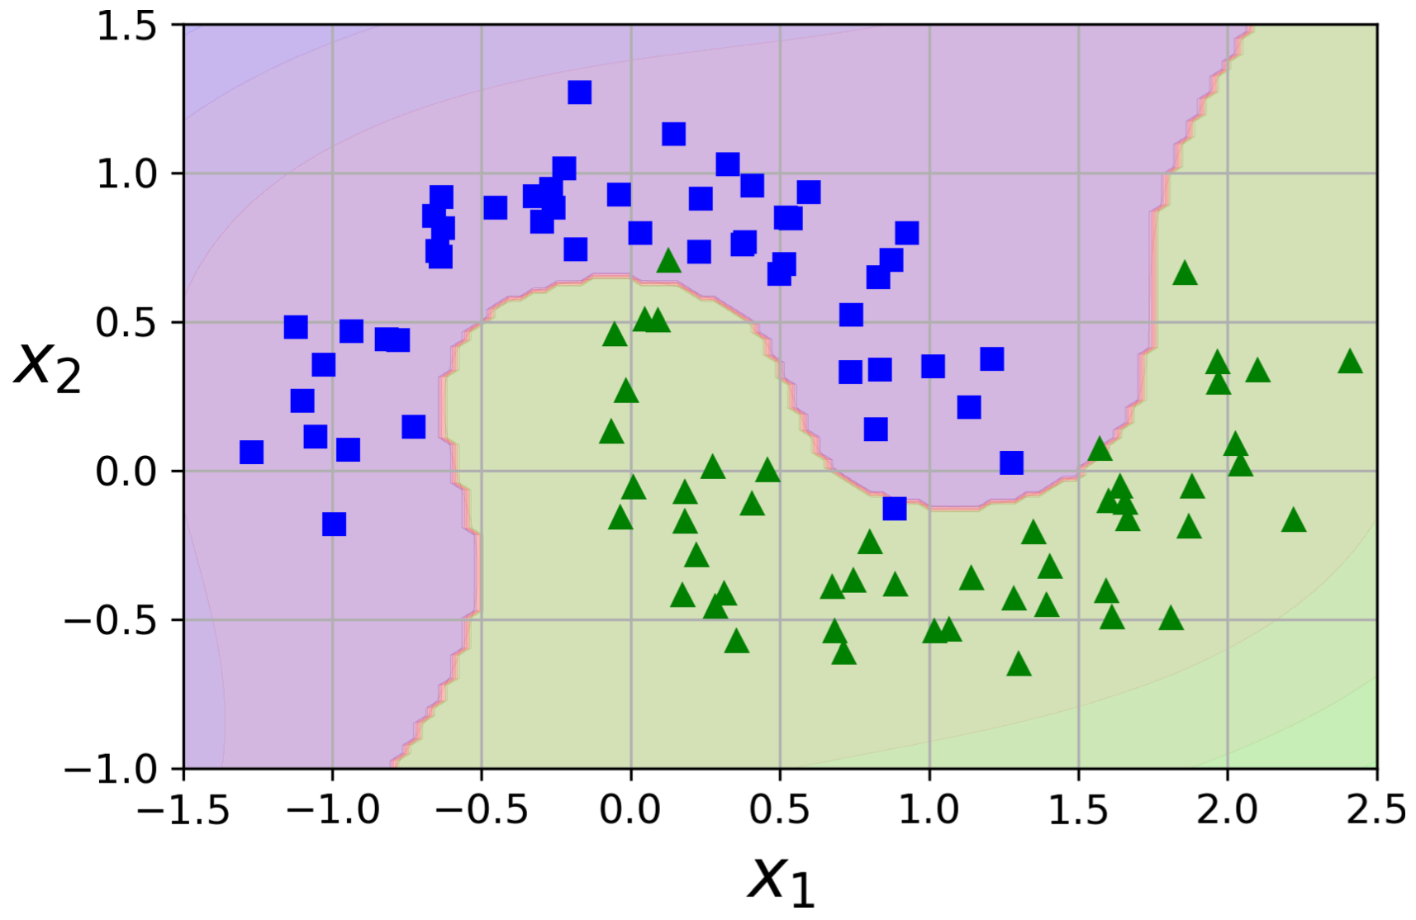
Nonlinear SVM Classification
Create a Pipeline containing a PolynomialFeatures transformer.
sklearn.datasets.make_moons. Make two interleaving half circles. A simple toy dataset to visualize clustering and classification algorithms.

Slide 15
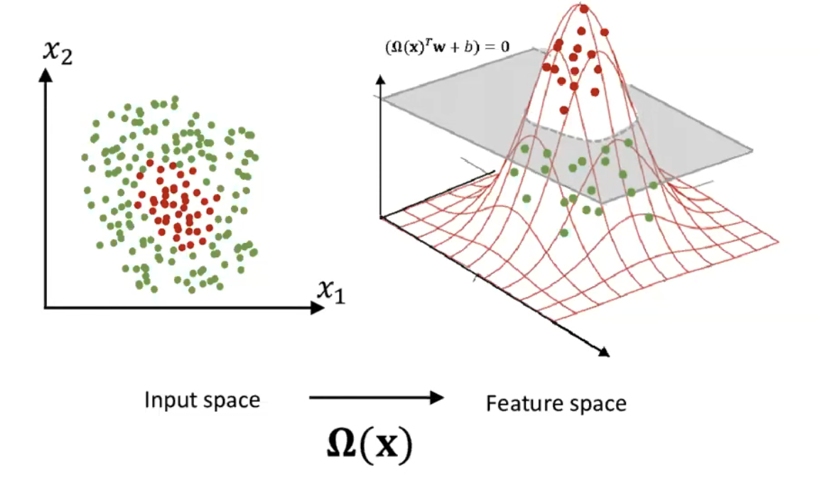
sklearn.svm.SVC
kernel{‘linear’, ‘poly’, ‘rbf’, ‘sigmoid’, ‘precomputed’}, default=’rbf’

Slide 16
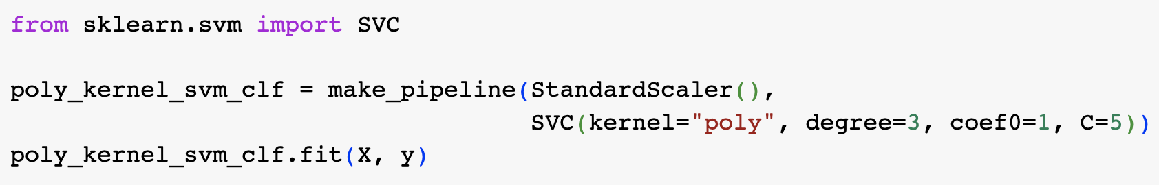
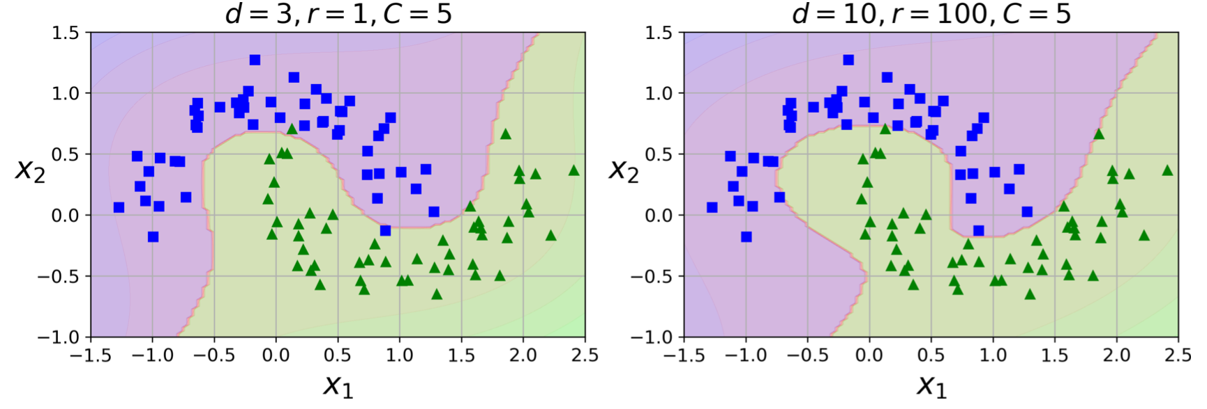
Nonlinear SVM Classification

Slide 17
Multi-class??
https://scikit-learn.org/stable/modules/svm.html
One-vs-Rest (OvR)
One-vs-One (OvO)

Slide 18
Exercise:
Use SVM on iris dataset
LinearSVC to separate virginica from non-virginica
Try non-linear options
(optional) expand to 3 class classification.

